Slide 1

Introduction to Neural Networks
Why is Deep Learning taking off?
deeplearning.ai
Notes:
Why now ?
Lets discuss some of main drivers to understand the growth of deep learning.

Slide 2
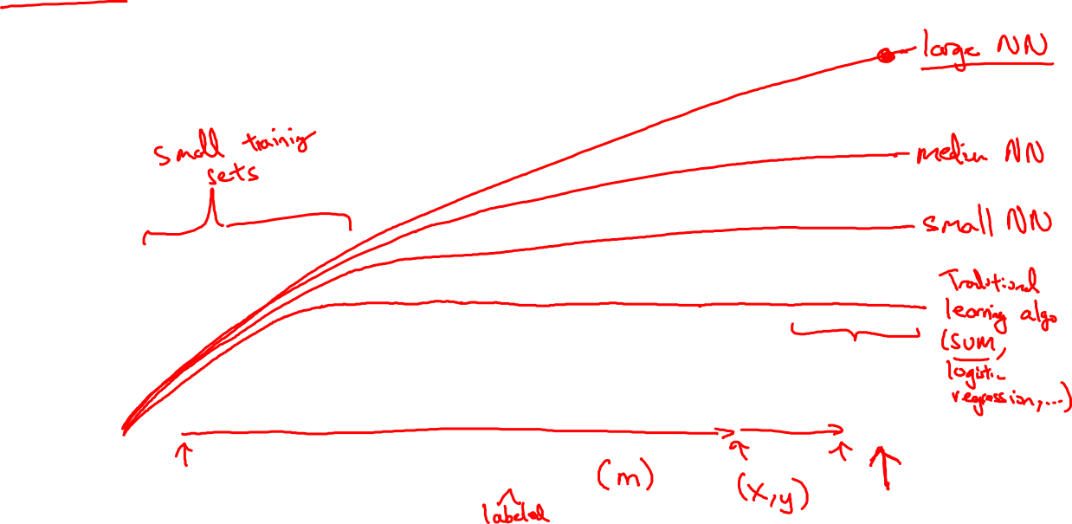
Scale drives deep learning progress
Performance
Amount of data
Notes:
Traditional learning algorithm plateaus, those traditional algorithm don’t benefit a lot from very large amount of data which has become abundant recently.
In case of a small NN, performance is shown by yellow curve where as in case of a large NN, its performance keeps getting better & better.
For this high accuracy, we need a lot of a lot of data & we need to be able to train a large network.
Scale has been driving the progress of Deep learning, scale of data & scale of NN.
These days, either we train a better/bigger network or throw more data at it.
m is the number of examples.
In case of small training data, the ordering of machine learning algos is not fixed, here relative ordering is not well defined, here performance depends upon the feature engineering & other techniques.

Slide 3

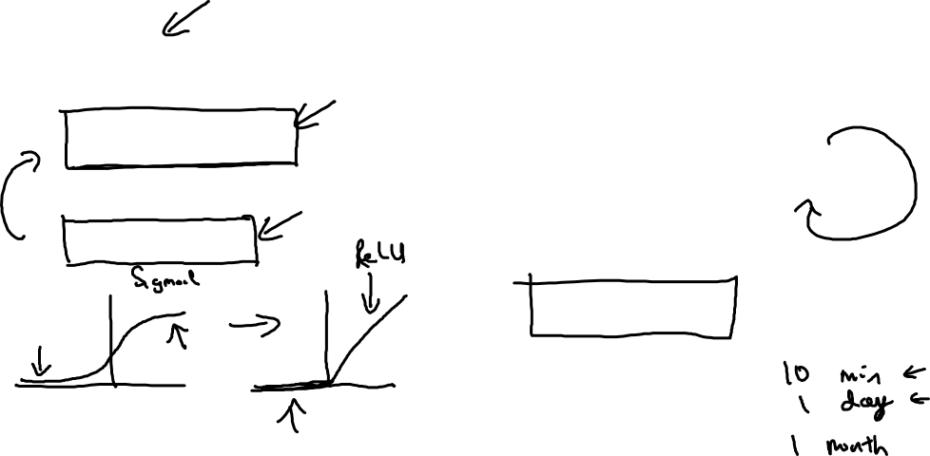
Scale drives deep learning progress
Idea
Data
Computation
Algorithms
Experiment
Code
Notes:
In recent years, there has been tremoundas approaches in algo, specialy to make NN run faster.
Faster computation has sped up the training experiments as well. Iteration of modeling has increased a lot.
An example is to switch from sigmoid to Relu. The difference is that when gradient is 0, the learning becomes vbery slow in case of sigmoid function.
Where as in Relu use as activation function the gradient = 1 for all positive values & it is very
by changing the what's called the activation function the neural network to use this function called the value function of the rectified linear
unit our elu the gradient is equal to one for all positive values of input right and so the gradient is much less likely to gradually shrink to zero and
the gradient here the slope of this line is zero on the left but it turns out that just by switching to the sigmoid function to the Relu function has
made an algorithm called gradient descent work much faster and so this is an example of maybe relatively simple algorithm in Bayesian but ultimately the
impact of this algorithmic innovation was it really hope computation so the regimen quite a lot of examples like this of where we change the algorithm
because it allows that code to run much faster and this allows us to train bigger neural networks

